Slide 1
Embedded System Final Project Intelligent Security Box
吳建翰、周子浩、張喬善

Slide 2
Project Revisited
To design a security box with a servo motor.
To handle NFC detection and web socket data transmission.
To design a backend to store user information.
To design a communication robot sending unknown-user warnings.

Slide 3
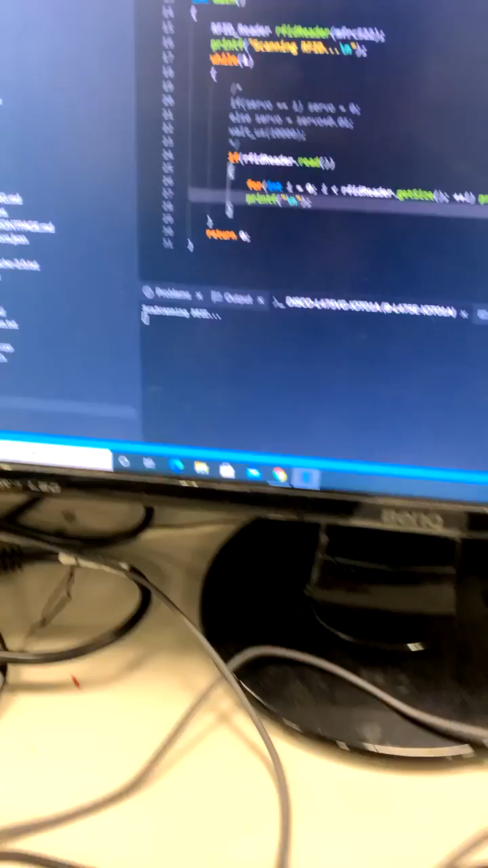
NFC Detection

Slide 4
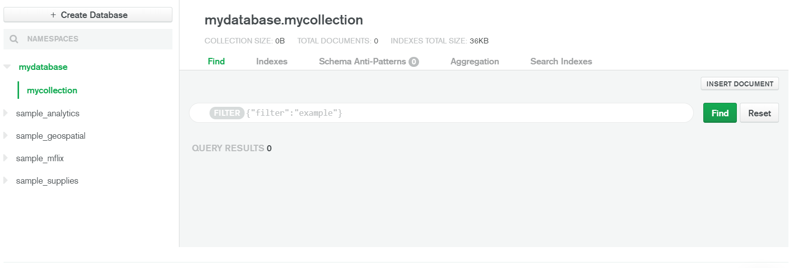
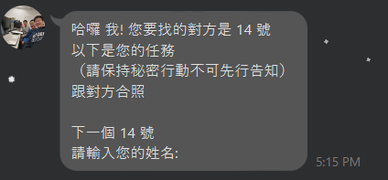
Backend & Linebot
Complete the interface with Mongo DB.
Complete the Linebot interface that the robot can reply to user.

Slide 5
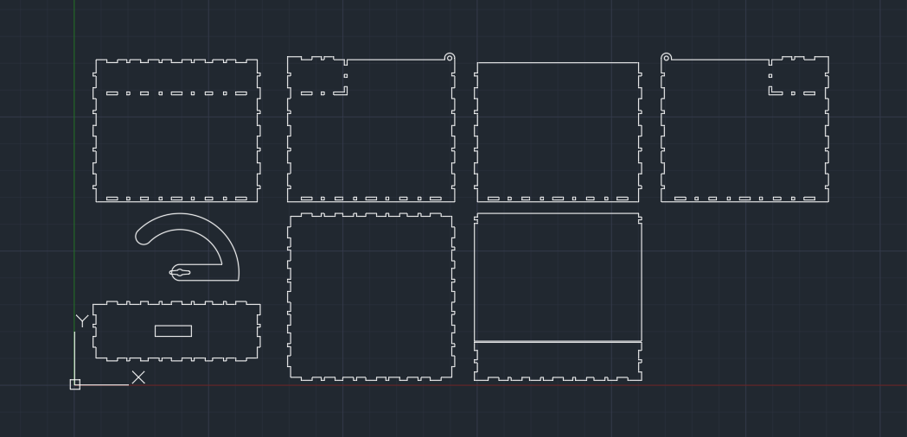
Wooden Box
Produced with laser cutting.

Slide 6
Schedule
We will complete the baseline in the next week.
Fingerprint recognition and acoustic recognition will be implemented with effort from the new year.

